Slide 1
Origins of the computer
Credits to these lecture slides : Rich Machlin

Slide 2
Class learning goals
To provide an overview of some of the big ideas and concepts of computer science
To give an understanding of what motivated the development of these ideas
Provide a sense of exciting current developments, and where the future lies
What this class is not:
  Not a programming course (try CMPS 5J, CMPS 5C, or CMPS 5P)
    Computer science is far more than just programming languages
  Not a computer literacy course (I assume you know how to use a computer)

Slide 3
The origin of computers
Where did computers come from?
Why did computers emerge in the 1940s?
How did computers differ from previous technologies for computation?
Threads in the story
  Charles Babbage / Ada Lovelace: Difference Engine, Analytical Engine
  Tabulating machines, card-based calculators
  ENIAC to EDVAC to UNIVAC and the birth of the commercial computing industry

Slide 4
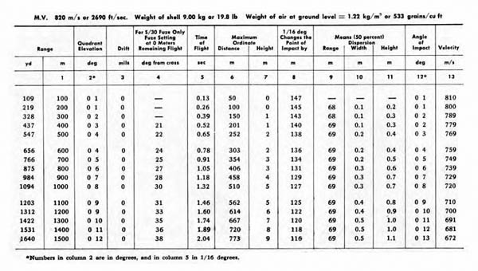
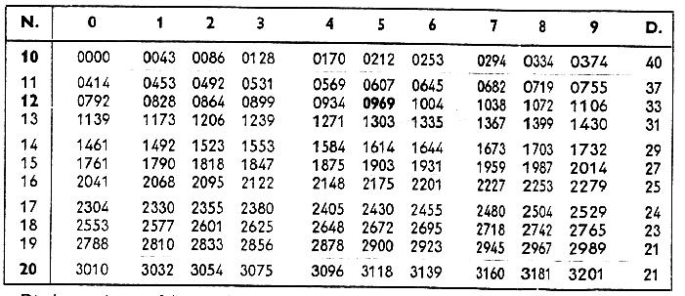
The Problem: Computation
Many important activities require computation
  Money lending
    A key activity in capitalist economic systems, requires the computation of compound interest for multiple interest rates
  Navigation
    Sailing over the open ocean requires the accurate calculation of current position
  Artillery
    Where to point artillery depends on the range of the target, weight of shell, etc.
    Each gun requires a different firing table
Computation takes time, and is error-prone
  Humans are not well adapted to perform complex computations
To reduce time and improve accuracy
  Books of numerical tables
  Pre-computed, and in theory free from error
Firing table for German 88mm anti-aircraft gun. (Specifically, for 8.8 cm FLAK 18 and 36 with 8.8 cm H.E. shell L/4.5 (Kz)* with time fuze S/30 OR P.D. fuze 23/28
www.lonesentry.com/manuals/88mm-antiaircraft-gun/german-88-mm-firing-tables.html
Portion of a table of logarithms.
The log N of a given number N, for example 125, is found by locating the first two digits, in this case 12, in the first vertical column and then the third digit in the labeled horizontal line, in this case 5. You thus find the mantissa 0969 and determine the characteristic 2 by the rule: (If a number > 1 has n digits before the decimal point, its characteristic is n -1), whence log 125 = 2.0969.
kr.cs.ait.ac.th/~radok/math/mat1/mat147.htm

Slide 5
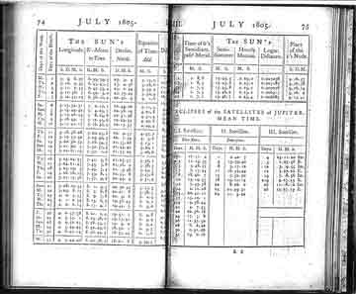
How were books of mathematical tables produced?
Beginning in 1767 England’s Board of Longitude had published a yearly Nautical Almanac
  Contains position tables for location of the sun, moon, starts, planets, and moons of Jupiter
  Useful for computing your location and date while at sea
A network of computers did the work of developing this book
  Thirty four men, and one woman,
  each working from their home
  Performed calculations by hand
  that went into the book
  Work often performed twice, by
  two different people, to check for
  errors
    Though, sometimes calculators
    copied from one another to save time…
Pages from Nautical Almanac, 1805
www.bookdrum.com/books/longitude/9780802715296/bookmarks-126-150.html

Slide 6
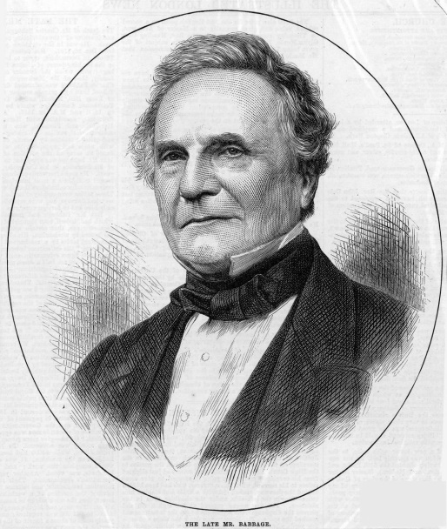
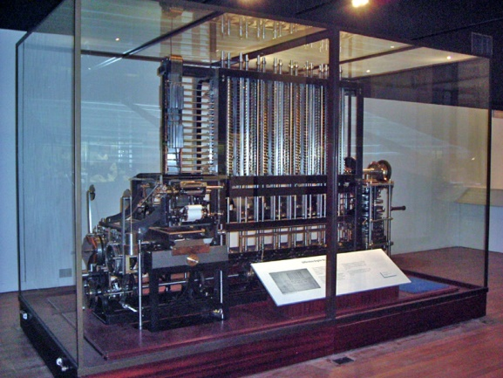
Charles Babbage
Charles Babbage (1791-1871), British
  Motivated by the desire to reduce drudgery of calculation, and to improve its accuracy
  “It is only by the mechanical fabrication of tables that (computation) errors can be rendered impossible.”
Was born in the steam age, when electronics was in its infancy
  As a consequence, thought to create a mechanical, steam-powered computing machine
  First machine was the Difference Engine, a mechanical calculator
    This was partially realized
  Second machine was the Analytical Engine, a programmable calculation device
Charles Babbage
en.wikipedia.org/wiki/File:Charles_Babbage_1860.jpg
Difference Engine
en.wikipedia.org/wiki/File:050114_2529_difference.jpg

Slide 7
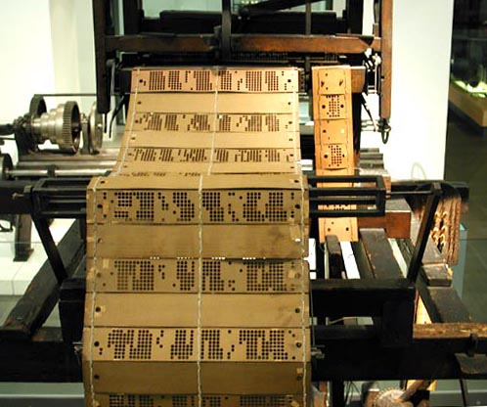
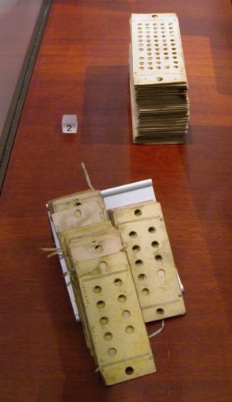
Analytical Engine
Jacquard loom (1801)
  Fabric patterns are encoded on punched cards
  Each row corresponds to one row of the fabric design
Babbage was inspired by this idea of abstracting the instructions away from the physical device that realizes them
  The goal of the analytical engine was to abstract apart the instructions for performing a computation
  Hence, one machine could perform a wide range of computations
  That is, it could be programmed
Jacquard loom
blog.lib.umn.edu/hael0002/alternativemedia5413/2011/02/the-jacquard-loom.html
Punched cards used to program analytical engine
en.wikipedia.org/wiki/Analytical_engine

Slide 8
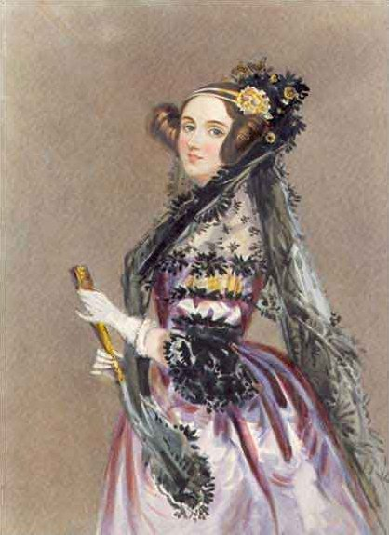
Ada Lovelace
Born 1816, daughter of Lord Byron (famous romantic poet)
A mathematical genius, worked with Babbage on Analytical Engine
  Documented the Analytical Engine, but more importantly…
Programmed Analytical Engine
  Though never realized, Ada developed a strong mental model of how it works, and then developed programs, also in her head, that ran on the machine.
  More impressively, these programs were recursive (re-running the same computation, using the results from the previous run-through)
Generally credited as being the world’s first computer programmer
She died age 36, from a painful, drawn-out battle with uterine cancer.
Watch:
  http://topdocumentaryfilms.com/creation-computer/
  “Computing by Steam” starts at 4:04
Ada Lovelace
en.wikipedia.org/wiki/File:Ada_lovelace.jpg

Slide 9
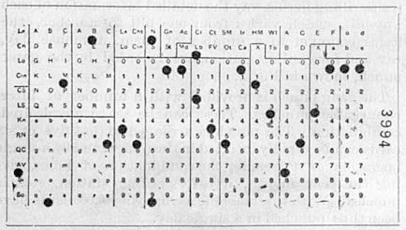
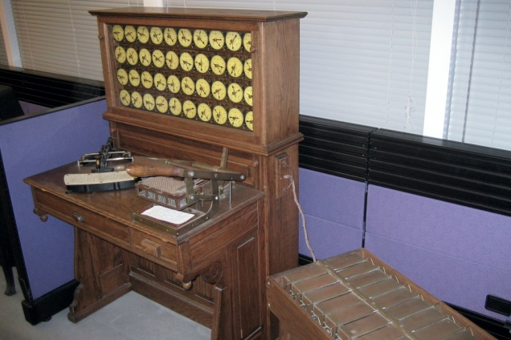
Tabulating the US Census: The crisis of 1890
US Constitution stipulates that the census is conducted every 10 years
  Results are used to create congressional districts, assign electoral votes to states, and are broadly useful in understanding the nation
1880 census took seven years to tabulate
  In 1880s, estimate was that 1890 census would take 13 years to tabulate!
Enter Herman Hollerith
  Inspired by train conductors punching holes in tickets who recorded traveler details using holes punched in tickets
  Realized that census data could be recorded on punched cards
    Cards were coded for age, state of residence, gender, and other information
  Using relays and solenoids (electrical equipment) it was possible to increment mechanical counters
  Cards sat over pools of mercury. Spring loaded wires would come down – if there was a hole, wire would go down into the mercury, completing a circuit.
Watch:
  http://topdocumentaryfilms.com/creation-computer/
  Saving the Census starts at 11:58
Hollerith Punched Card
en.wikipedia.org/wiki/Tabulating_machine
Hollerith 1890 tabulating machine and sorter
en.wikipedia.org/wiki/Tabulating_machine

Slide 10
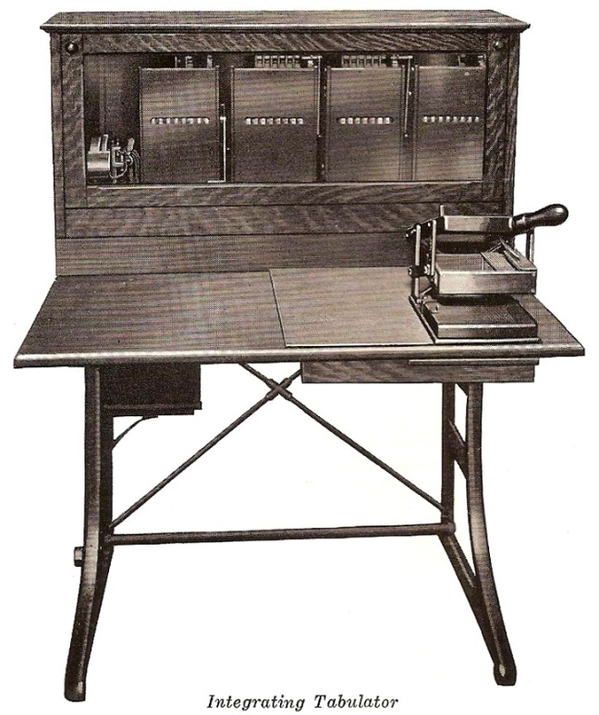
Aftermath of 1890 census
Benefits of tabulating technology were immediately apparent for tracking inventory and accounting
Hollerith founded Tabulating Machine Company in 1896
  Hollerith Integrating Tabulator could add numbers coded on cards
    Shift to arithmetic, not just counting
In 1911, four similar firms merged to form Computing Tabulating Record Corporation (CTR)
In 1924, CTR was renamed International Business Machines (IBM)
Hollerith Integrating Tabulator
www.officemuseum.com/data_processing_machines.htm

Slide 11
Punched card computation
Typical punched card computation
  Stack of cards holds numbers
  The same operation (e.g., addition, multiplication) is performed on all cards as they are read through the device
  This works well for most business uses (accounting, inventory control)
Engineering and scientific computing
  Increasing use of mathematical analysis in engineering and science led to increased need for computation in these fields
  In engineering, especially complex systems of first and second derivatives, that were difficult or impossible to solve analytically
  Many times, these computations required multiple operations to be performed on each number (card), not just one
  Worse, sometimes the next number to be operated on depended on the output of a calculation on the prior number

Slide 12
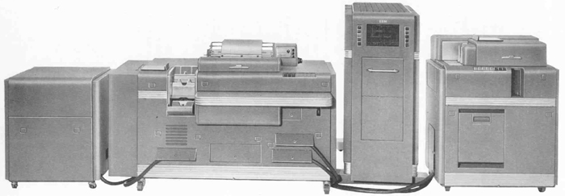
Punched card computation (cont’d)
Needs of scientific and engineering computing led to creation of what are essentially lightly programmable card computers
  Aberdeen Relay Calculator
    Allowed up to 12 predefined computational steps (later up to 48) to be performed on each card
    Why Aberdeen? This is the location of the US Army Ballistic Research Laboratory (Aberdeen, Maryland)
    IBM had a similar machine (IBM 604)
  IBM Card-Programmed Calculator (CPC), 1949
    Allowed a sequence of calculations to be encoded on punched cards
    Permitted the programming of a
    calculator using punched cards
    Holes on a card would refer to the
    operations performed by specific
    circuit board, hence the same program
    would behave differently on different
    CPCs, depending on their circuits
IBM Card Programmed Calculator (Model A1) Left to right: Type 941 Storage Unit, Type 412-418 Accounting Machine, Type 605 Electronic Calculator, Type 527 High-Speed Punch
www.columbia.edu/acis/history/cpc.html

Slide 13
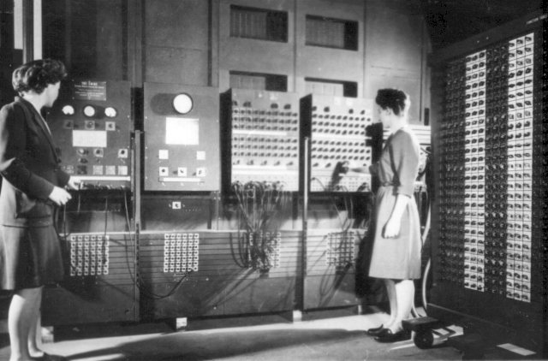
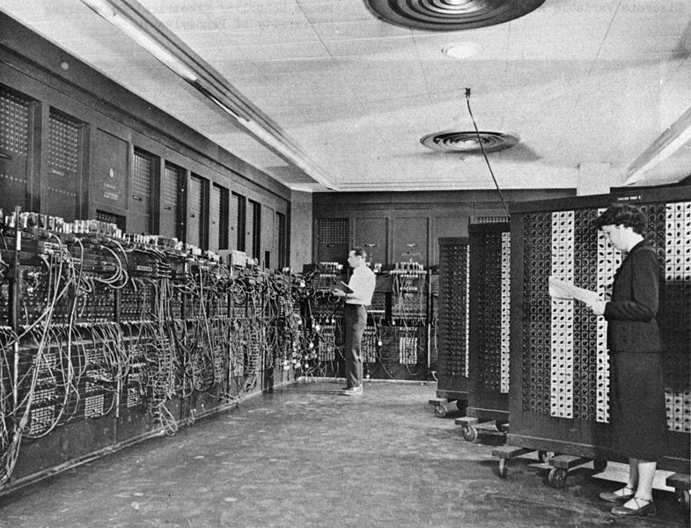
ENIAC
Electronic Numerical Integrator and Calculator
  Designed to compute artillery tables for US Army Ballistic Research Laboratory
  Development began during WWII, but was completed in 1946
  Conceived and designed by John Mauchly and J. Presper Eckert at Univ. of Pennsylvania
ENIAC could be programmed
  Complex sequences of instructions, could include loops, branches, and subroutines
  Taking a problem and mapping it onto the machine was complex, often took weeks
  Once a potential mapping was put onto paper, the process of getting the program into the ENIAC took days of manipulating cables and switches
  Not a stored program computer
Watch:
  First computer ENIAC (footage of setting up an ENIAC)
    http://www.youtube.com/watch?v=VAnhFNJgNYY
  The Philadelphia Brain
    http://topdocumentaryfilms.com/creation-computer/
    Starts at 21:51
Programmers Betty Jean Jennings (left) and Fran Bilas (right) operating ENIAC
en.wikipedia.org/wiki/ENIAC
Programmers Betty Snyder (foreground) and Glen Beck (background) program ENIAC
en.wikipedia.org/wiki/ENIAC

Slide 14
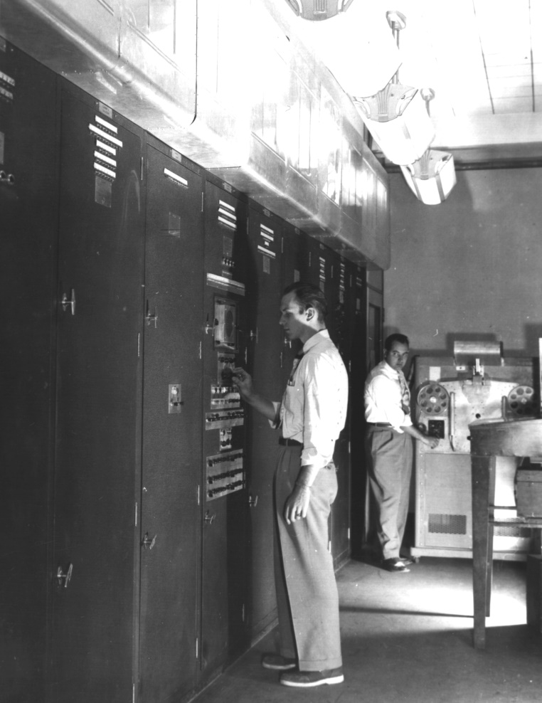
EDVAC
A follow-on to ENIAC
  Electronic Discrete Variable Automatic Computer
  Project initiated by John Mauchly and Presper Eckert
Key idea: stored program computing
  To avoid problem of long setup times, make this kind of setup controllable by the instructions themselves
  “An important feature of this device was that operating instructions and function tables would be stored in exactly the same sort of memory device as that used for numbers.”
  This notion of stored-program computing has been central to every computer that has come since
Stored program computing in modern terms:
  The same memory is used for storing data and for storing programs.
  A program is just an interpretation applied to certain kinds of data.
  Builds on Alan Turing’s idea of a Turing Machine
EDVAC
en.wikipedia.org/wiki/EDVAC

Slide 15
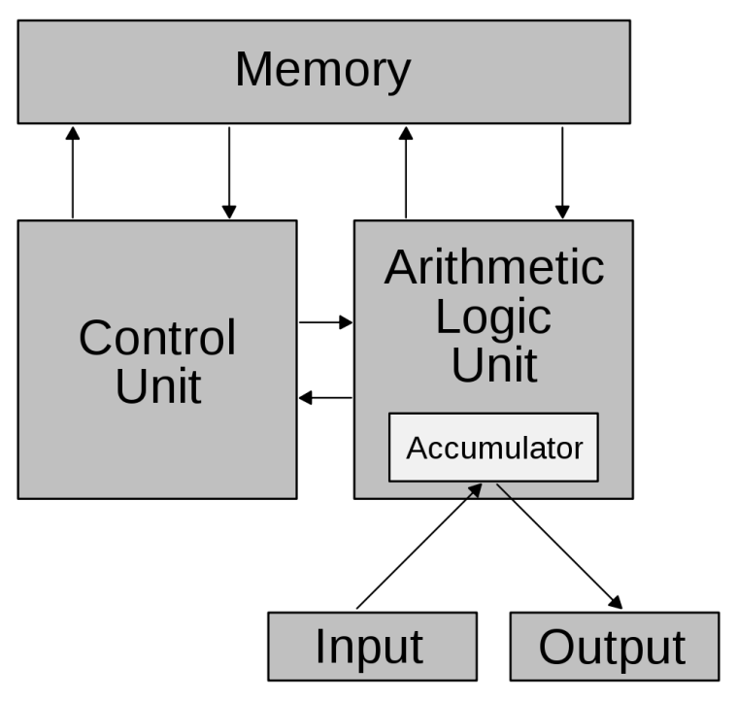
Von Neumann Architecture
John von Neumann distilled out the key ideas behind EDVAC in a report titled, “First Draft of a Report on the EDVAC”
  Clarified ideas by Eckert, Mauchly, & Turing
Describes the key notion of a stored program computer
  Computer includes an instruction set
  Computer memory can include either data or program instructions
  Computer fetches an instruction from memory, decodes & executes it, then fetches the instruction in the next memory location, etc.
    Called the fetch-execute cycle
  “Sometimes I think the only universal in the computing field is the fetch-execute cycle” – Alan Perlis
Watch:
  http://topdocumentaryfilms.com/creation-computer/
  The Pathfinders begins at 26:16
Von Neumann Architecture
en.wikipedia.org/wiki/Von_Neumann_architecture

Slide 16
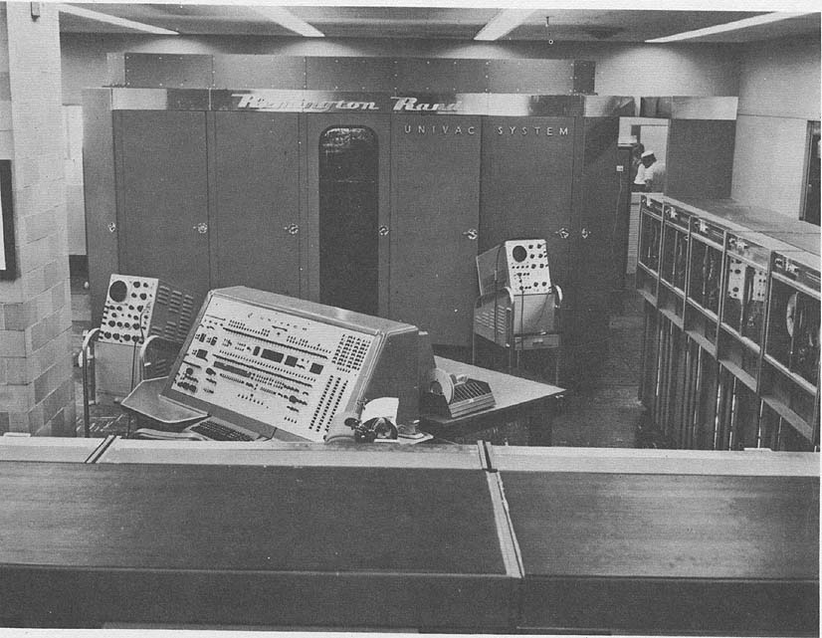
UNIVAC
In 1946, Irwin Travis, an administrator at the Univ. of Pennsylvania:
  Asked members of the staff to sign a release form
  Would prevent them from receiving royalties on their inventions
  Eckert and Mauchly refused to sign, and resigned.
Formed a company, the Eckert-Mauchly Computer Corporation
  Built BINAC, a one-off computer for Northrup Grumman (not successful)
  Then focused on UNIVAC (Universal Automatic Computer) the first commercial computer
  Launched the commercial computer industry
  Had difficulty raising capital, achieving initial sales
  Sold to Remington-Rand corporation in 1950
  In 1951, first UNIVAC was completed for US Census Bureau
UNIVAC I
en.wikipedia.org/wiki/UNIVAC

Slide 17
Review: Key Ideas
Abstracting the calculation away from the computing device
  Babbage’s punched cards
Putting data into machine-readable form
  Use of punched cards for data (Babbage and Holerith)
A program as a series of instructions
  Babbage Analytical Engine, card programmable calculators, ENIAC
Stored program computer
  Using electronic memory for both instructions and data
  John Von Neumann, John Mauchly, J. Presper Eckert: EDVAC, UNIVAC

Slide 18
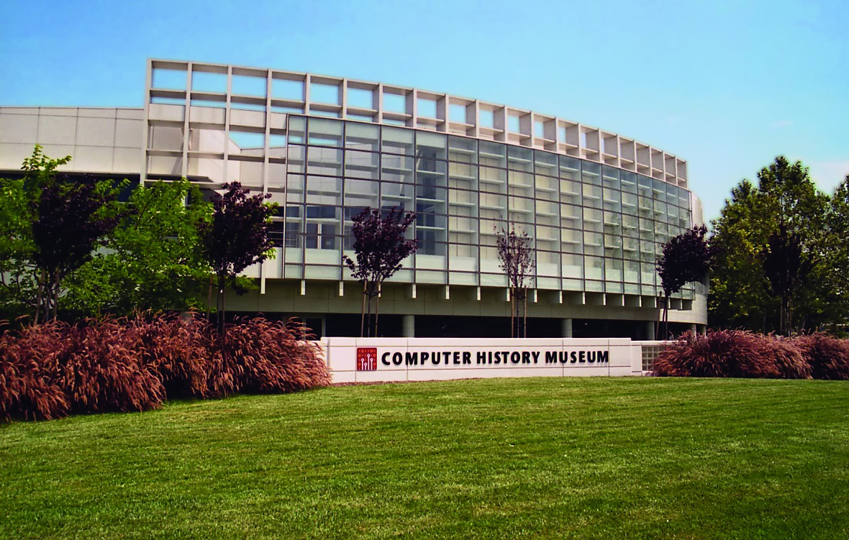
Computer History Museum
Perhaps the best computer history museum in the world
Current exhibit:
  Revolution: First 2000 Years of Computing
    New exhibit on the history of computing
Also, excellent
permanent collection
www.computerhistory.org

